Slide 1

PROFESSIONAL LAND SERVICES www.penterraservices.com

Slide 2
AL
ALABAMA
ND
NORTH DAKOTA
AR
ARKANSAS
NM
NEW MEXICO
CO
COLORADO
OH
OHIO
IL
ILLINOIS
OK
OKLAHOMA
KS
KANSAS
PA
PENNSYLVANIA
LA
LOUISIANA
TX
TEXAS
MS
MISSISSIPPI
WV
WEST VIRGINIA
MT
MONTANA
WY
WYOMING
PENTERRA PROVIDES PROFESSIONAL LAND SERVICES ACROSS THE NATION
www.penterraservices.com

Slide 3
Penterra provides the services you need, when you need them
Unique skill sets and expertise in every aspect of your project
Management team with over 100 years of combined land service experience
Flexibility to adjust to client needs
Extensive work history in multiple states
In-house and field experience
we are Committed to exceeding expectations!
www.penterraservices.com

Slide 4
PENTERRA
VALUES
MANAGER ROLES
Communicate expectations
Encourage and support new processes and ideas
CONTRACTOR EXPECTATIONS
Accountability
Accuracy
Results oriented
Innovation
Professionalism
Respect
Collaboration
Hard work
Teach efficiency and accuracy
Encourage teamwork
Efficiency
Integrity
Hard work
Teamwork
DEFINED ROLES AND RESPONSIBILITIES!
www.penterraservices.com

Slide 5
SUPPORT AS NEEDED FOR ALL PHASES OF ANY PROJECT!
MANAGEMENT
PROSPECTING
Collect GIS data
Identify research resources
Review of data/research
Mapping / GIS data
Budgeting / Estimation
Brokerage cost
Leasing / Acquisition cost
Report submittal
DEVELOPMENT
Title research
Surface, Mineral, Royalty, WI, NRI, NPRI
Liens & Mortgages
Leasing / Asset acquisition
Abstracting / Runsheet's
Curative
Due Diligence
Unit review
Interested party and Respondent lists
SUA acquisition / Damage settlement
Data / Agreements management
Reporting
Progress
Budget
In-house land personnel
Land administration
Confirm company interest
Identify obligations
Extensions, Expirations
Rentals
Well commitments
Well proposals
Prepare assignments, subleases, releases
Lease review
Division orders
Ensuring contractual compliance
Data Management
Experience with multiple land databases
Secure data storage
DIVESTURE
Seller Due Diligence
VDR reviews and analysis of land assets
High-level lease check
Determine leasehold, defects and calculate values
Vendor cost
Division Order Analysts
Open source and proprietary data collection
Asset preparation and summary
Consents to assignment
Preferential rights to purchase
Curative
Identify potential defects
Cure defects
Closing document preparation
Asset Transition

Slide 6
LAND SERVICES
LEASING/ACQUISITIONS
Continuously working fields from the first phase of leasing and acquisitions until full development. Acquisitions include: minerals, royalty, ORRI, non-HBP and HBP leasehold, wellbores, SWD and surface.
ABSTRACTING/RUNSHEETS
Assist clients in the acquisition and divesture of over eight (8) billion dollars of assets.
CONTRACT IN-HOUSE LAND PERSONNEL
Penterra has grown as a provider of quality in-house land personnel to meet the ever-changing needs of exploration companies’ land departments. In-house contractors can provide cost savings to your bottom line and lower overhead expenses associated with hiring and terminating employees. Through this cost savings, Penterra offers its services in assisting firms in stabilizing labor costs and growing their energy investments. Penterra’ s adaptable processes, use of technology, network of landmen, lease analysts, title opinion analysts, division order analysts, and other land personnel saves overhead costs, and puts value back into the properties.
Research and compile 1,000s of abstracts / runsheets for timely submissions.
CURATIVE
Assist clients in surface location acquisition, settlement of damages, flowline/ROW, water rights, frac pits, SWD well acquisition and surface access/ROW for wind and solar permitting.
WELL READINESS
Drilling program management from planning phase through production, well proposals/elections, JOAs, DOI setup. Have prepared over 400 horizontal wells to be drilled from initial setup through Division Orders.
DUE DILIIGENCE
Review 1,000s of title opinions, satisfy requirements critical for client / attorney approval and well preparation.
SURFACE / WATER
RENEWABLES
Initial review using open source and proprietary data.
Acquisition
Site selection
www.penterraservices.com

Slide 7
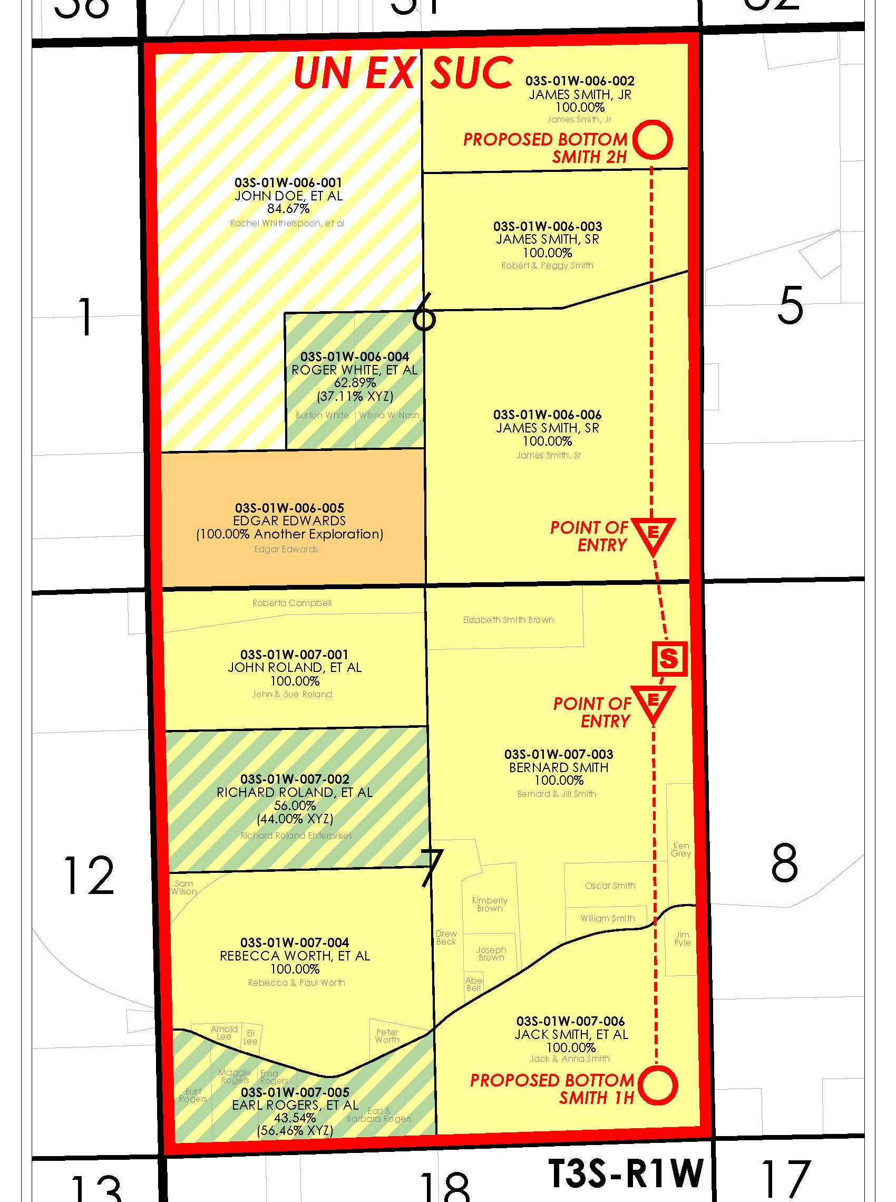
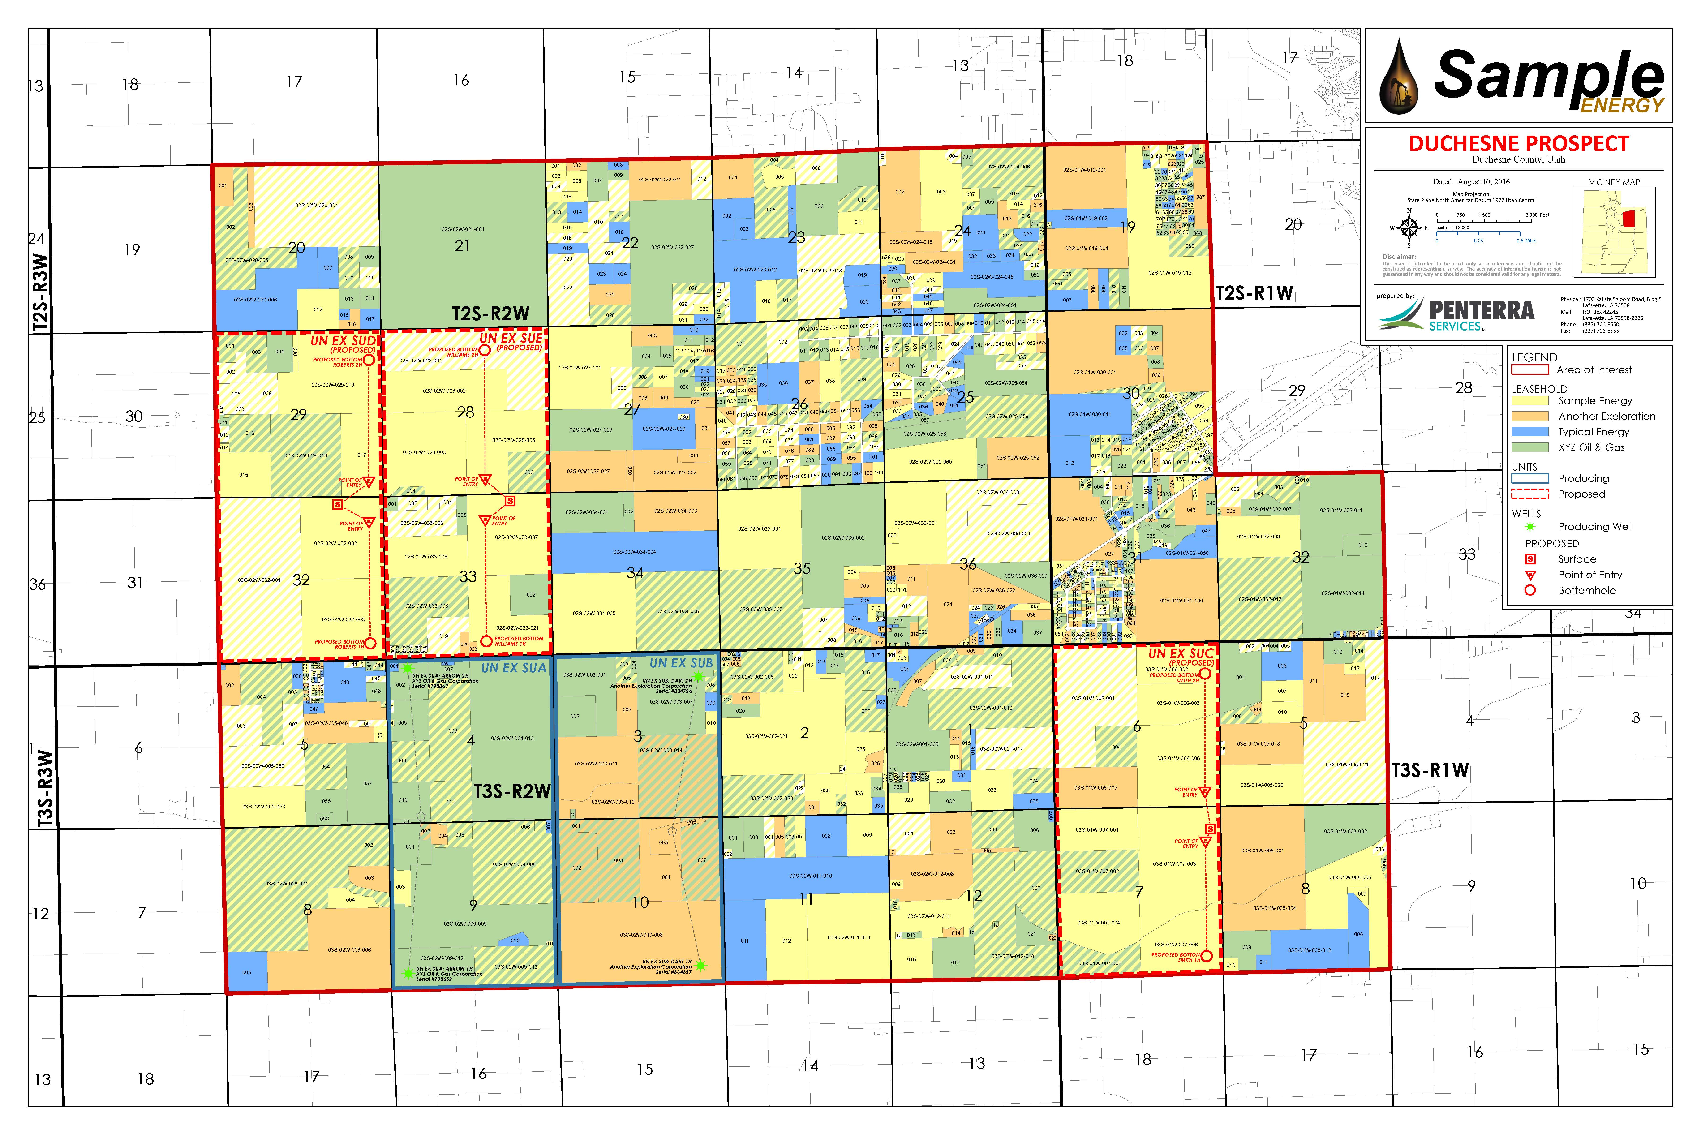
MAPPING / GIS:
Brand and personalized mapping
Integration of assessment, conservation, aerial, data sets, and reports visualizing spatial relationships
Leases, leasehold, units/pooling, locations, ROW, etc.
Open source and proprietary data collection
www.penterraservices.com

Slide 8

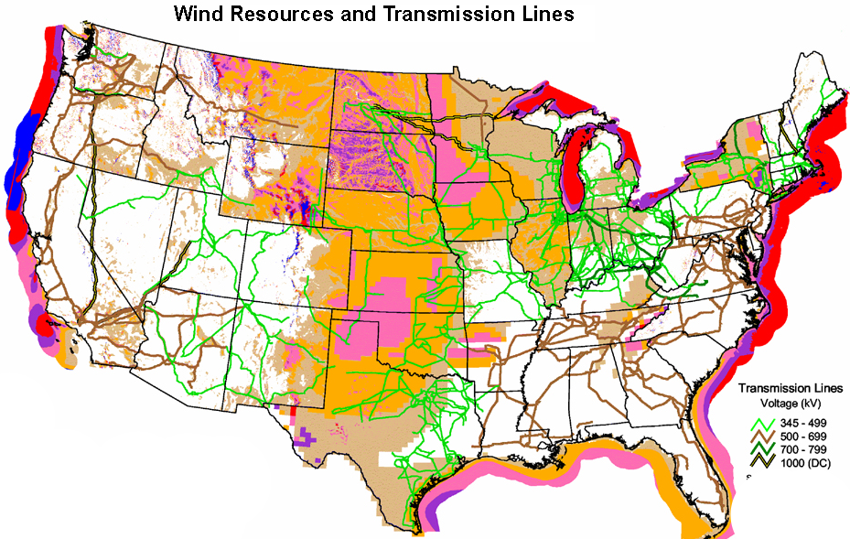
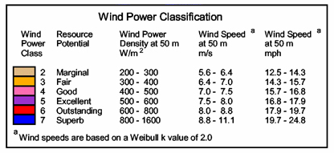
Site Selection – Using open source and proprietary data, identify:
Budgeting
Existing land use
Existing wind & solar resource farm locations
Existing transmission & substations locations
Surface ownership
Prior use of land
Encumbrances
Ability to provide accurate estimates for work to be performed
Ability to work within a budget
Title
Runsheets
Abstracts
Title reports
Acquisition
Land purchase
Easement, ROW, or SUA
RENEWABLE ENERGY
Solar Stations
Wind Farms
Power Storage Facilities
Easements/Rights of Way
www.penterraservices.com

Slide 9
WE PROVIDE LAND SERVICES FOR MULTIPLE INDUSTRIES:
Oil & Gas
Geothermal
Solar
Wind
Real Estate
www.penterraservices.com

Slide 10
PENTERRA SERVICES, LLC
Anschutz Exploration
Ascent Resources
Bison Oil & Gas
Bruin E&P Partners
Diamondback Energy
Encino Energy
Felix Energy
Fortis Minerals
Gary Permian
Gulfport Energy
Mack Energy
Nadel and Gussman
Oseberg
Ossidiana Energy
Reign Capital
Riley Exploration
Rimrock Oil & Gas
Pontem Energy Capital
Tribune Resources
Southwestern Energy
Stronghold Resource Partners
Viper Energy
Whiting Oil & Gas
Will-Drill Resources
WPX Energy
Zavanna
89 Energy
Chesapeake Energy
Validus Energy
OUR CLIENTS:
www.penterraservices.com

Slide 11
LOUISIANA OFFICE MANAGEMENT TEAM:
Owner / Manager
David L. Dauterive, CPL
Mark W. Lipari
Owner / Manager
A 29 year veteran in the land services industry, Mark has earned a reputation for his integrity and business acumen among clients and colleagues alike. Driven to exceed expectations, he is able to produce results by successfully balancing the demands of clients with the detail needed to deliver a superior product. He understands that each client is different, and adjusts manpower, technology and reporting based on the needs communicated by the client.
Mark’s experience includes Oil and Gas, Governmental and other private land related projects in all areas across the country. Within the Oil and Gas industry, Mark’s project management experience includes large and small / conventional and unconventional projects - leasing, mineral acquisition, seismic permitting, due diligence, abstracting, run sheets, curative, pipeline rights-of-way, surface and sub-surface leases/rights-of-way. Mark‘s experience also includes working directly with the client in developing budgets and strategies to best develop the client’s areas of interests and needs. His successful track record has naturally led to working with private enterprises outside the realm of Oil and Gas, parlaying his knowledge and experience into helping these clients achieve their goals. Mark is graduate of Louisiana State University in Baton Rouge and belongs to several professional associations, including the American Association of Professional Landmen and the Oklahoma City Association of Professional Landmen.
A Certified Professional Landman, David received his Bachelor of Science degree in Finance from Louisiana State University and A&M College in 1987 before earning his Master of Science degree in Environmental Studies in 1992. His education and extensive professional experience managing conventional and non-conventional land prospects for the oil and gas industry allow this consummate landman to bring a distinctive set of skills to the table. Drawing from over 25 years of project management, David has a relatable perspective on the unique objectives and demands required by differing prospects and on attaining the various goals set by his clients.
David prides himself on his aptitude for directing a diverse group of people, including title attorneys, surveyors, state agencies, land owners, and contractors toward a common goal. David’s attention to detail and aptitude for creating outstanding client relationships motivate him to provide relevant prospect reports, schedules, spreadsheets, maps, and other data customized to each client’s unique needs.

Slide 12
OKLAHOMA & COLORADO OFFICE MANAGEMENT TEAM:
Partner
Managing Partner
John Schieber
Born and raised on the family farm in central Oklahoma, John has a unique understanding and appreciation of the oil and gas industry. His personal perspectives of exploration at a local level inspires him to promote a positive image within the industry and community on behalf of Penterra and its clients. John manages Penterra’ s eastern United States operations.
John is a graduate of Oklahoma State University, earning his degree in Business Administration. He began his career at Chesapeake Energy where he began to cultivate his passion professionally for the oil and gas industry, while working on multiple projects in several states including Ohio, Pennsylvania, West Virginia and Oklahoma. His demanding schedule and developed management skills make him highly effective in both the advancement and completion of projects.
He currently manages a diverse group of attorneys and landmen in a variety of task associated with the Marcellus and Utica plays, including abstracting, leasing, title curative, and due diligence.
John is a member of the American Association of Professional Landmen and the Oklahoma City Association of Professional Landmen.
John and his wife, Beth, are the proud parents of three very active children that keep them busy in their spare time. When John does have a chance to relax, he enjoys golfing, hunting, and cheering on his Cowboys.
Kyle Nevels
A lifelong Oklahoma resident and former college baseball player, Kyle earned his Bachelor’s degree in Business Administration and his Masters of Education from the University of Central Oklahoma. Kyle serves as the managing partner of Penterra Service's Edmond, OK office.
With six years of in-house landman experience at Chesapeake Energy and SandRidge Energy, Kyle possesses a unique perspective on land services operations, including an intimate knowledge of the demands, pressures, and expectations of corporate upper management. Kyle prides himself on his ability to manage multiple prospects from the beginning stages through full development. He brings an exceptional facility with joint operating agreements, leasing deals, due diligence projects, research, and managing budgetary concerns to the Penterra Services Team. Since opening the Edmond office in 2012, Kyle has built a team of 75 plus landmen and a wide range client base. They have acquired over 150,000 net acres of leasehold, handled over 200 acquisitions and due diligence transactions totaling over $6B and have prepared over 80 horizontal units to be drilled. They have handled projects in Colorado, Illinois, Kansas, North Dakota, Ohio, Oklahoma, Pennsylvania, Texas and West Virginia.
Kyle belongs to a number of professional associations, including the American Association of Professional Landmen, the Oklahoma City Association of Professional Landmen and Denver Association of Petroleum Landmen. Kyle is also available for Oklahoma Corporation Commission expert witness testimony.
Kyle and his wife, Stephanie, are the proud parents of twin girls, Campbell and Sophie, and a son, Burke. Kyle enjoys spending time outdoors, golf and cheering on his favorite local sports teams.
Justin Shannonhouse
Land Manager / Business Development
Justin was Born and raised in Oklahoma City. While playing collegiate golf, he earned his Bachelor’s degree in Business Administration from Southern Nazarene University. Justin started his career as a Landman immediately after graduating from SNU. He excelled in title and worked his way up to Prospect Manger where he managed up to 30 field brokers in various exploration plays across the Lower 50. In early 2013, Justin headed for the hills. He accepted an in-house Land position in Denver, CO with Kodiak Oil and Gas where he focused on managing a multi-drilling rig program in North Dakota. During his time at Kodiak, which later became Whiting Oil and Gas, he was exposed to various unique land and operational challenges managing the only Indian/Federal Unit in the United States, located on the Fort Berthold Indian Reservation (“FBIR”) in North Dakota. Justin also spent extensive time working with the BLM, BIA as well as the Mandan, Hidatsa and Arikara (“MHA”) testifying before the MHA’s Natural Resource Committee and the Tribal Business Council on various issues ranging from right-of-way negotiations to the expansion of the Twin Buttes Indian/Federal Unit. Justin also has experience testifying before the North Dakota Industrial Commission as an expert Land witness regarding various Land and Regulatory affairs. After Whiting sold its FBIR asset to Rim Rock in 2017, he accepted a Senior Land position at Bruin, where he had the honor and pleasure to continue working assets located on the FBIR, as well as other fee assets across the Bakken. Justin possesses a unique ability to adapt to new challenges and understands exactly what it takes to effectively manage a drilling program in a fast paced, politically challenging environment. He prides himself on his uncanny transparency and enjoys solving complicated issues as they arise. Justin is an Registered Petroleum Landman, member of The American Association of Professional Landmen and Denver Association of Petroleum Landman.
Justin and his wife live in Golden Colorado where they are in the process of raising a beautiful 2 year old girl and a shaggy German Wirehaired Pointer.

Slide 13
LOCATIONS:
LOUISIANA OFFICE
PHYSICAL ADDRESS
1700 Kaliste Saloom Road, Bldg 5
Lafayette, Louisiana 70508
Phone: 337-706-8650
Fax: 337-706-8655
MARK W. LIPARI
Office 337-706-8650 Ext. 205
mlipari@penterraservices.com
MAILING ADDRESS
P.O. Box 82285
Lafayette, LA 70598-2285
DAVID L. DAUTERIVE, CPL
Office 337-706-8650 Ext. 206
Cell 337-298-2366
ddauterive@penterraservices.com
OKLAHOMA OFFICE
PHYSICAL ADDRESS
15314 N. May Avenue
Edmond, OK 73013
Phone: 405-726-2762
Fax: 405-726-2768
KYLE NEVELS
Office 405-726-2762 Ext. 300
knevels@penterraservices.com
MAILING ADDRESS
P.O. Box 7383
Edmond, OK 73083
JOHN SCHIEBER
Office 405-726-2762 Ext.321
Cell 405-243-6602
jschieber@penterraservices.com
COLORADO OFFICE
MAILING ADDRESS
P.O. Box 16189
Golden, CO 80402
Phone: (405) 249-9937
JUSTIN SHANNONHOUSE
Office 405- 726-2762 Ext. 322
Cell: (405) 249-9937
jshannonhouse@penterraservices.com
www.penterraservices.com

